Slide 1

Car Prediction Price Analysis
Machine Learning Case Study
Submitted by, M.Kavitha.

Slide 2
ACKNOWLEDGMENT
This presentation includes the Car price prediction done by myself with reference to the data analysis prepared by me using web scraping from the website Cars24 .Also referred to Google for some detailed learning in the analysis report writing for the completion of the project.
INTRODUCTION
Business Problem Framing
With the covid 19 impact in the market, we have seen lot of changes in the car market. Now some cars are in demand hence making them costly and some are not in demand hence cheaper. One of our clients works with small traders, who sell used cars. With the change in market due to covid 19 impact, our client is facing problems with their previous car price valuation machine learning models. So, they are looking for new machine learning models from new data. We have to make car price valuation model.
· Conceptual Background of the Domain Problem

Slide 3
In this section,We scraped the data of used cars from websites (Cars24).We used web scraping for this. We fetched data for different locations. The number of columns for data depends on the proper scraping we are doing and also the website which we are scraping .
The dataset contains the data of the used car.On the basis of the data we have to predict the price of the car.The dataset contains the data like 'name', 'year', 'transmission', 'mileage', 'owner', 'fuel', 'price', 'model', 'location' details of the used car.
Review of Literature:
I started the Research by first reading and analyzing the data collected by myself . SalePrice is the target column here. All the features are then analyzed, missing data handling, outlier detection, data cleaning are done. New features are extracted, redundant features dropped and categorical features are encoded accordingly. Then the data in split into train and test data and feature scaling is performed.

Slide 4
· Motivation for the Problem Undertaken
The main Objective behind the project is to perform the given task successfully and analyze the dataset thoroughly, learn the objective concepts and perform the prediction according to the provided dataset.
Analytical Problem Framing
· Mathematical/ Analytical Modeling of the Problem
1.Importing modules, Reading the data 2.Analyzing Numerical Features
Checking Statistical summary
Checking Distribution of numerical features . Inspecting Correlation
Missing Value Handling
Encoding Categorical Features Correcting data type
Univariate and Bivariate analysis, DataVisualization.
3.Analyzing Categorical Features

Slide 5
Missing Value Handling
Encoding Categorical Features Data Visualization
Dropping Redundant Features 4.Splitting data into Train and Test data 5.Comparing model coefficients 6.Model Evaluation
Choosing the final model and most significant features.
Evaluation of Regressor Models
HyperParameter Tuning. 10.Conclusion.
Data Sources and their formats
Data contains 5984 entries each having 9 variables.
Data does not have Null values.
Extensive EDA is performed to gain relationships of important variables and price.
Data contains numerical as well as categorical variables.
We have to build Machine Learning models, apply Regressor model coefficients and determine the optimal values of Hyper Parameters.

Slide 6
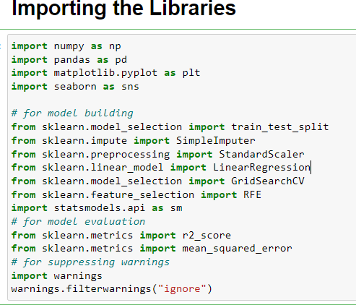
We need to find important features which affect the price.
Data Description:
First, we will import the required libraries:
Importing Dataset

Slide 7
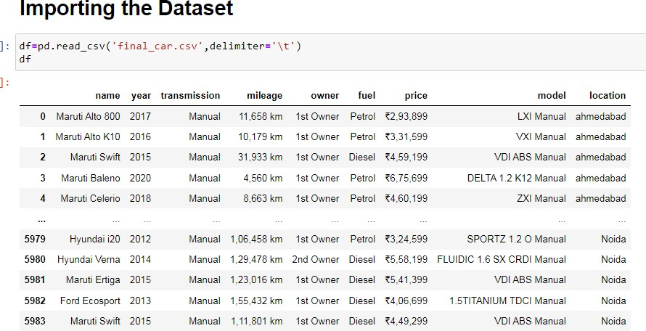
Once the data is collected ,we perform several steps to explore the data.The Aim of this step is to get the better understanding of the data structure,do initial preprocessing,clean the data,check for skewness,outliers,missing values,do encoding
,standard scale the dataset and finally build the model.
Understanding the data:
In the first part of the dataframe is evaluated for structure,columns,data types.we use basic pandas functions to perform these steps.

Slide 8
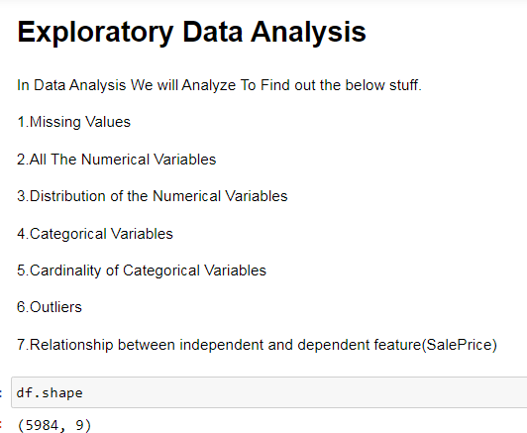
We start by analyzing the pricing of the car and find out which variable is important in selecting a used car for the best driving and significant in predicting a price of a new car.
The data provided consists of car model ,types and price,Also it tells about the fuel type whether it is petrol,diesel.
In the collected dataset there were no null values and duplicate records .

Slide 9
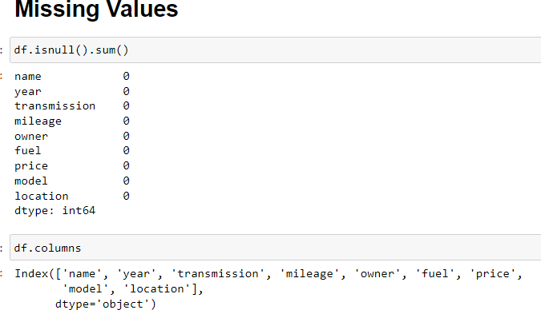
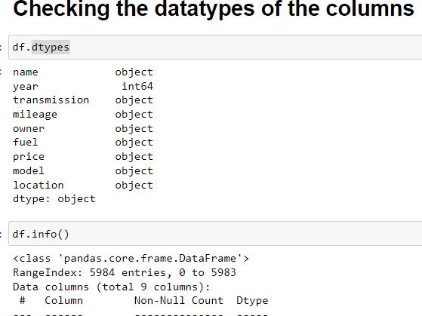

Slide 10
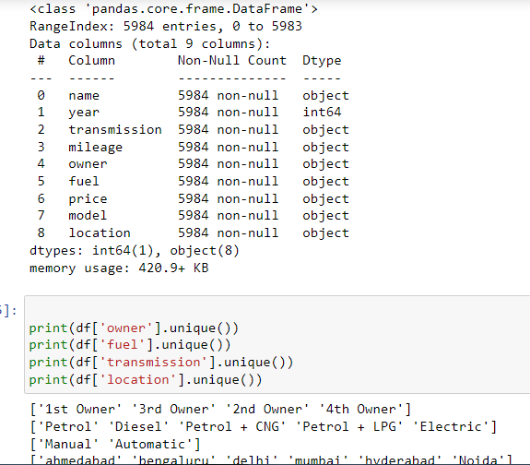

Slide 11
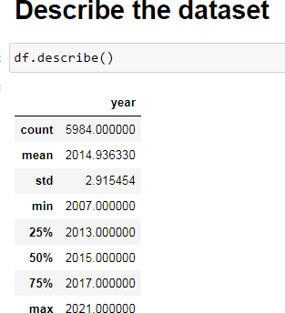
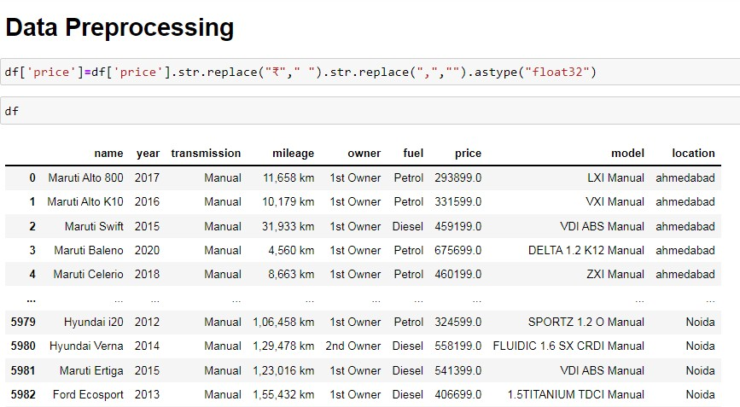

Slide 12
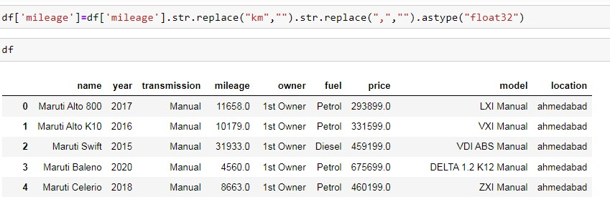
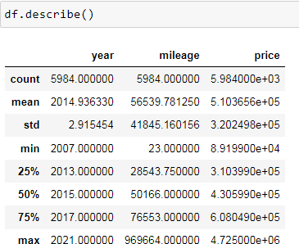
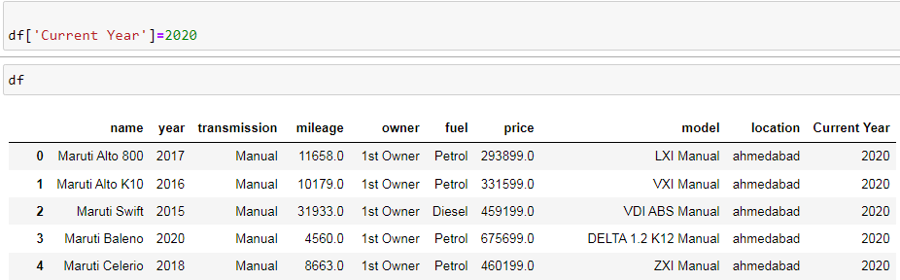

Slide 13
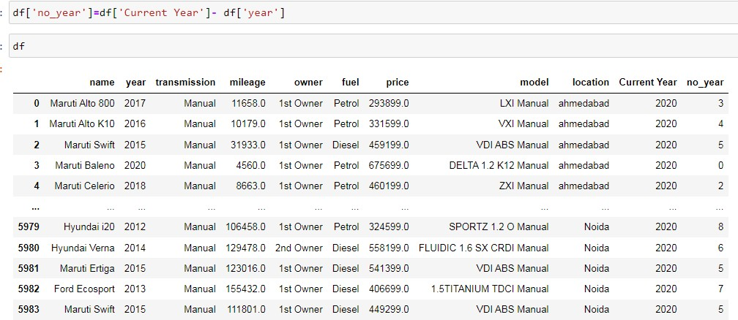
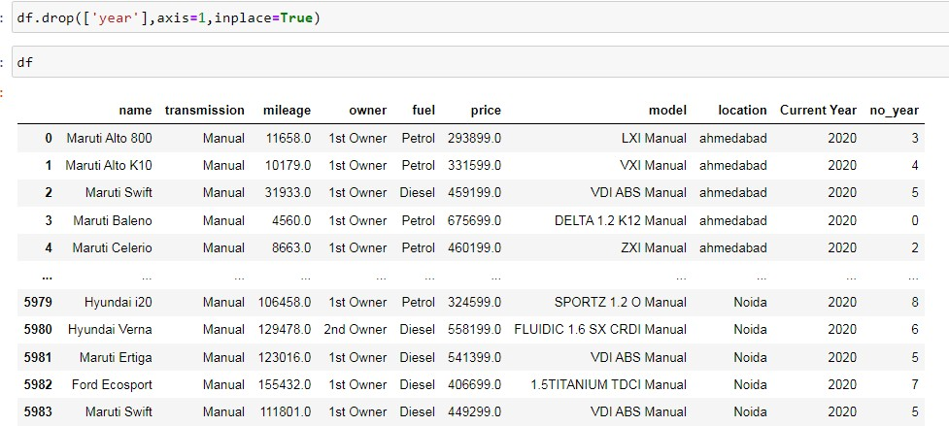

Slide 14
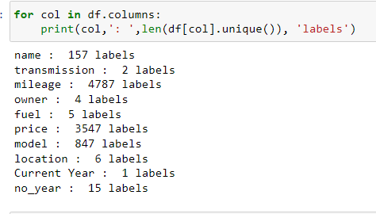
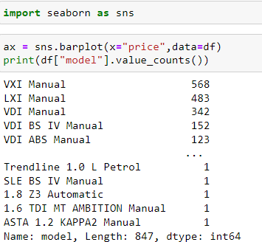
Made all these observations from the exploratory data analysis.

Slide 15
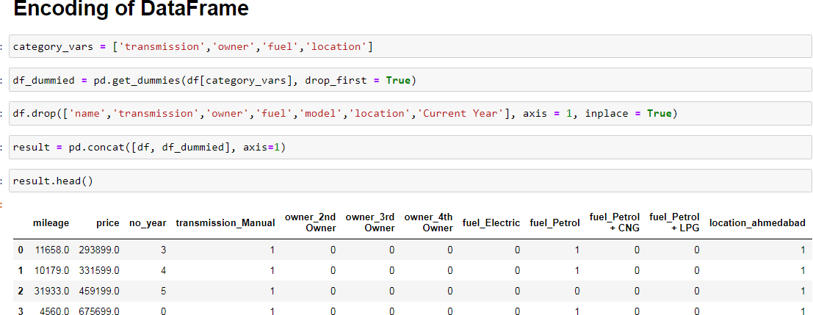
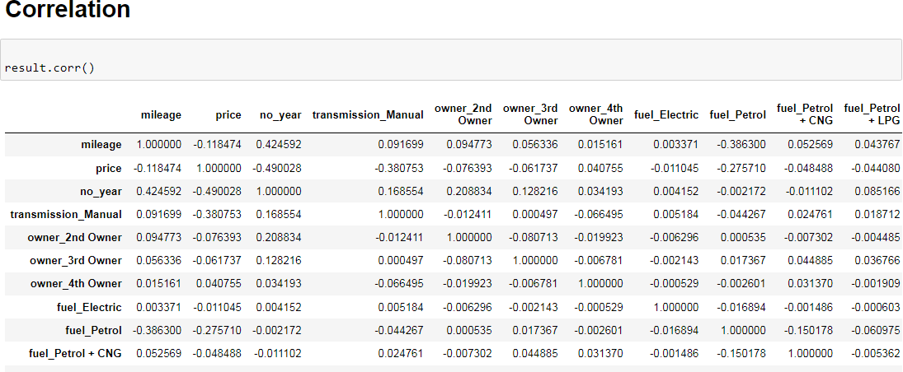
Getting Statistical Analysis for the numerical features:

Slide 16
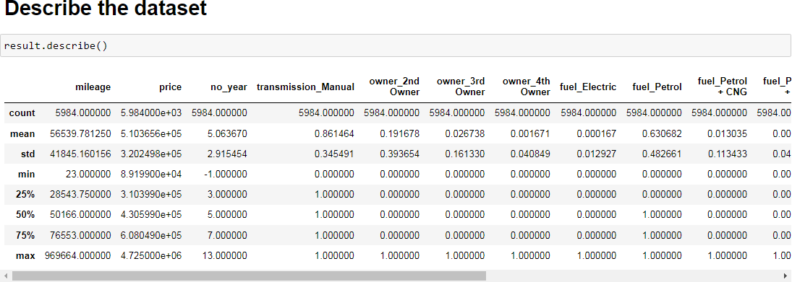
Comments:
Derived the new column current year ,so that i can create a new column number of years the car was used in accordance with dataset created and dropped the current year column and the year column.,I make a note of
Derived new variables as and when necessary. Also converted the mileage column from km to m conversion as string type.
Converted the price column from rupees to float32 for the ease of calculation.
derive the variables as and when required and convert the variables to the correct data type.
Also checked the company name and model name of the car which varies according to the price of the car.

Slide 17
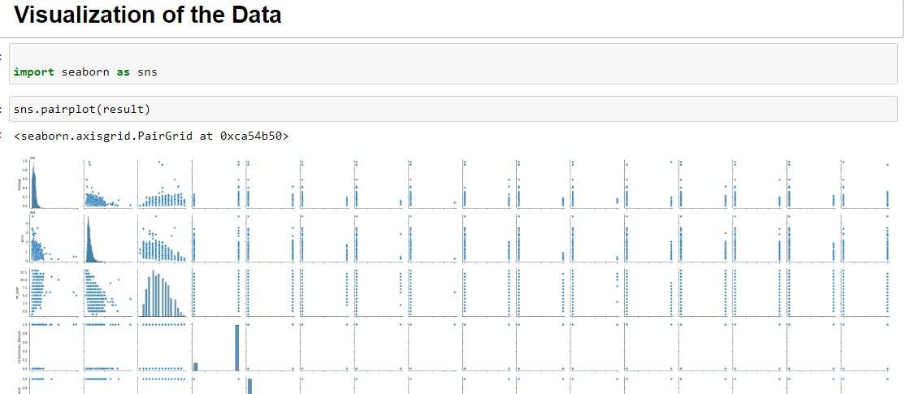
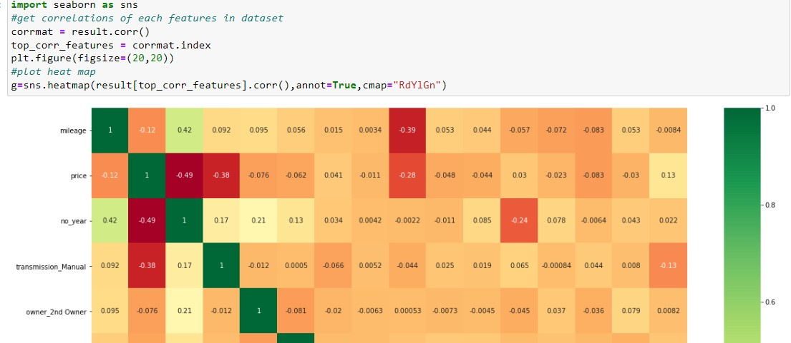
I checked the summary statistics of numeric variables.
Did the correlation plot of all the numeric variables.to understand which are positively correlated and which variables are negatively correlated.
The price column is highly correlated,and the features with dark green color are highly positively

Slide 18
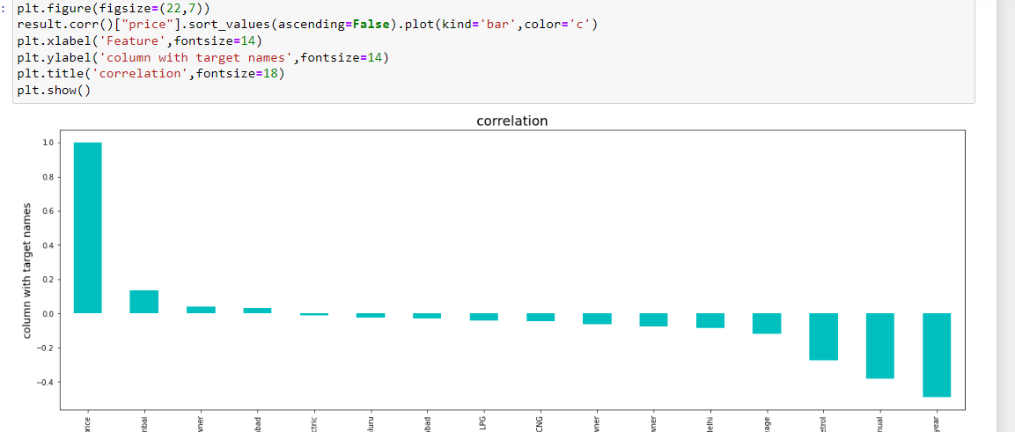
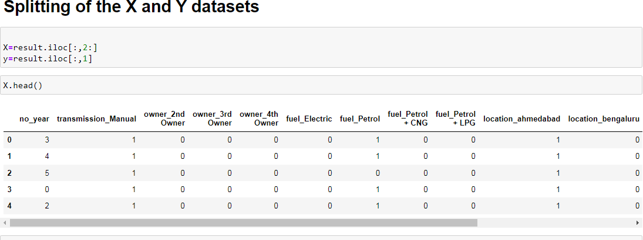
correlated. The columns with red color are negatively correlated. The column fuel type petrol is negatively correlated.
Data Visualization:
Model Development and Evaluation

Slide 19
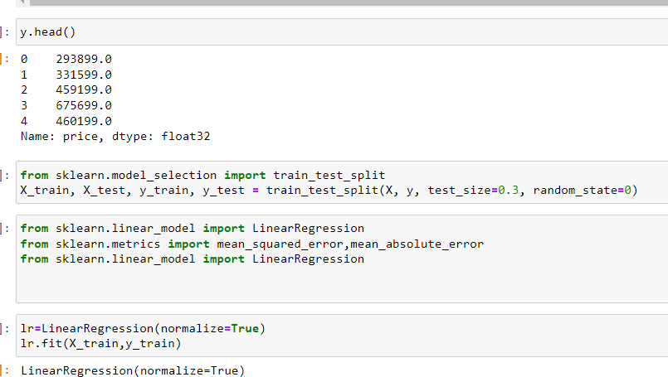
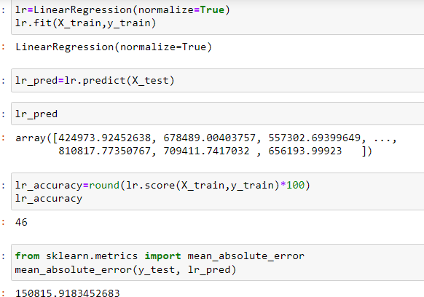

Slide 20
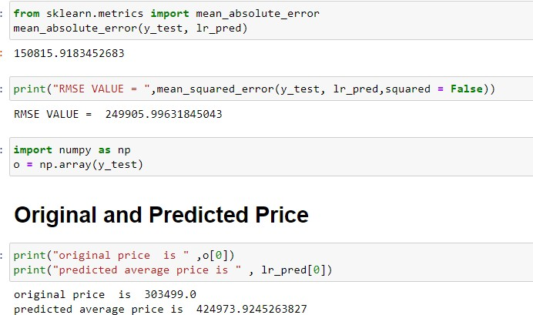
Run and Evaluate selected models

Slide 21
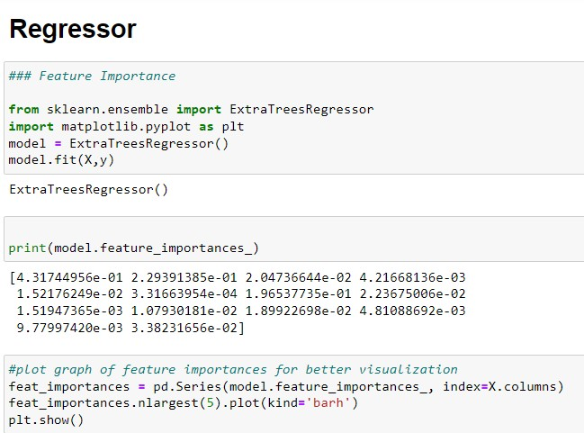

Slide 22
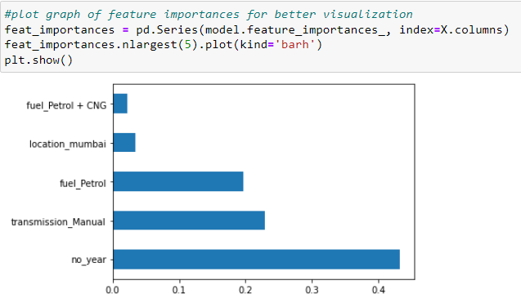
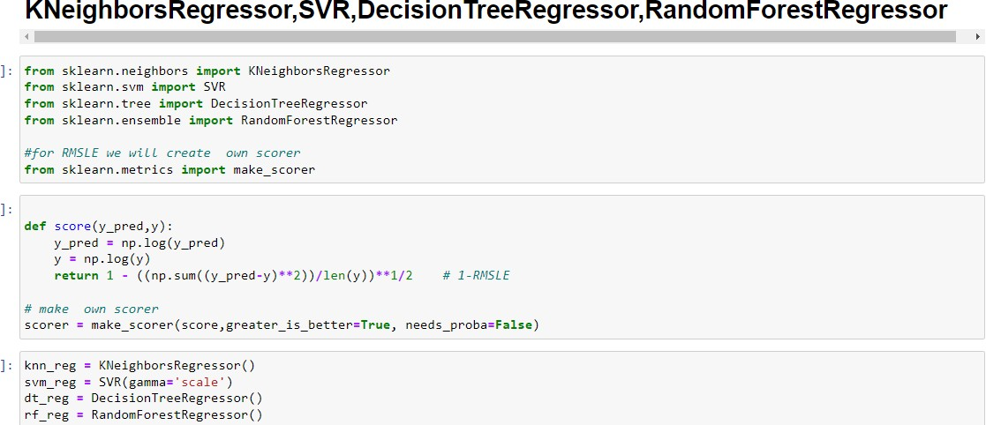

Slide 23
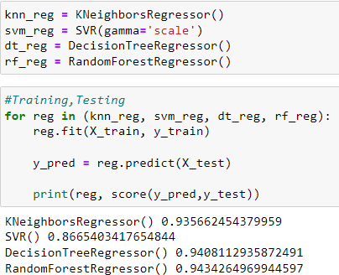
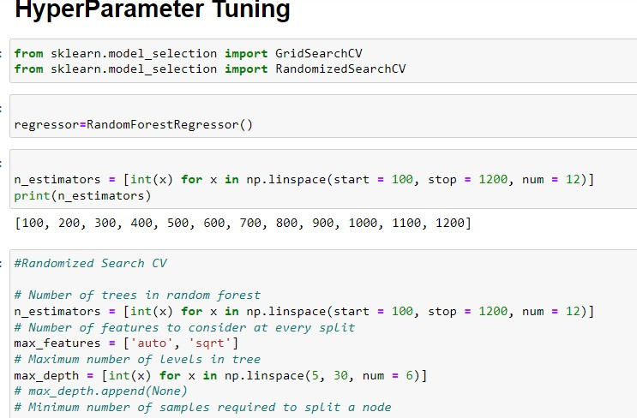

Slide 24
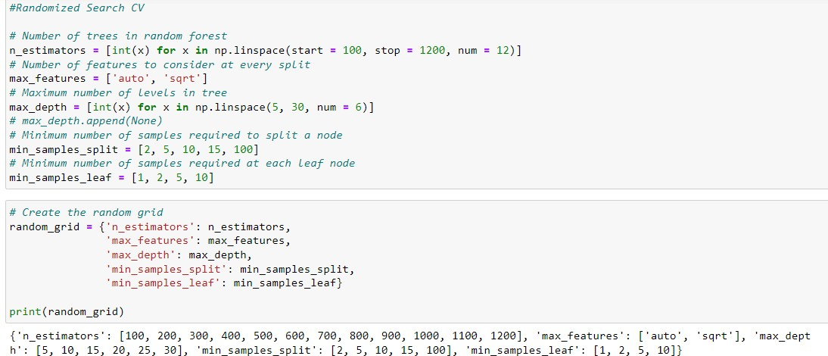
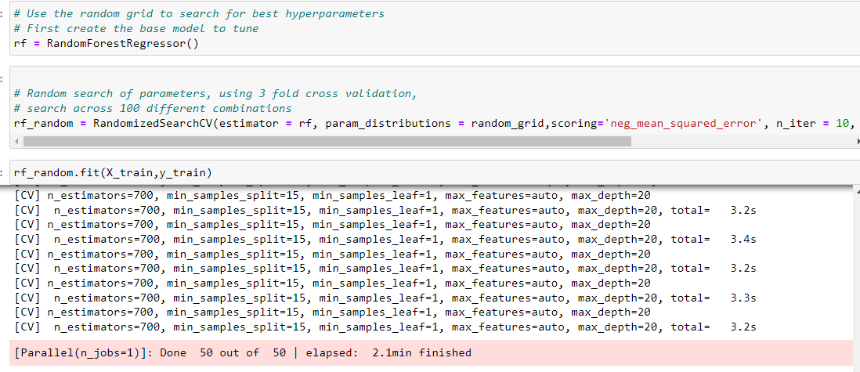
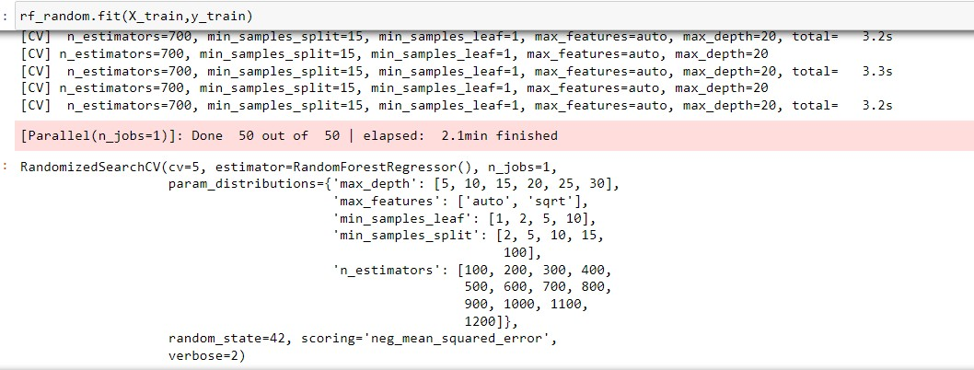

Slide 25
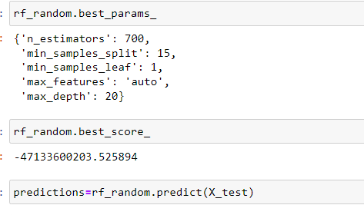
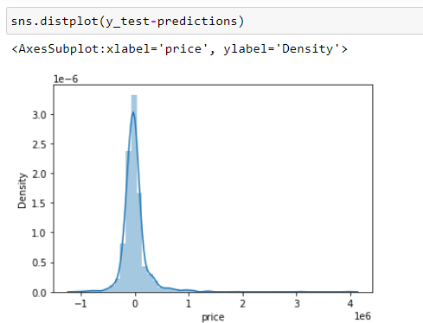

Slide 26
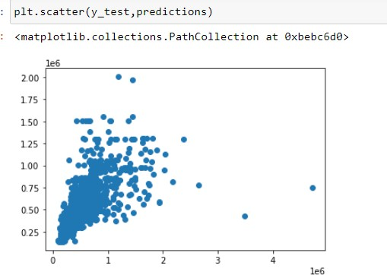

Slide 27
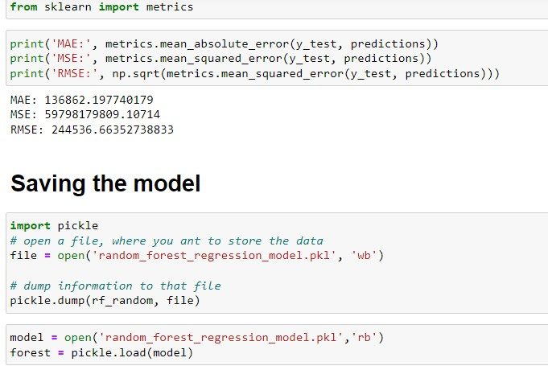
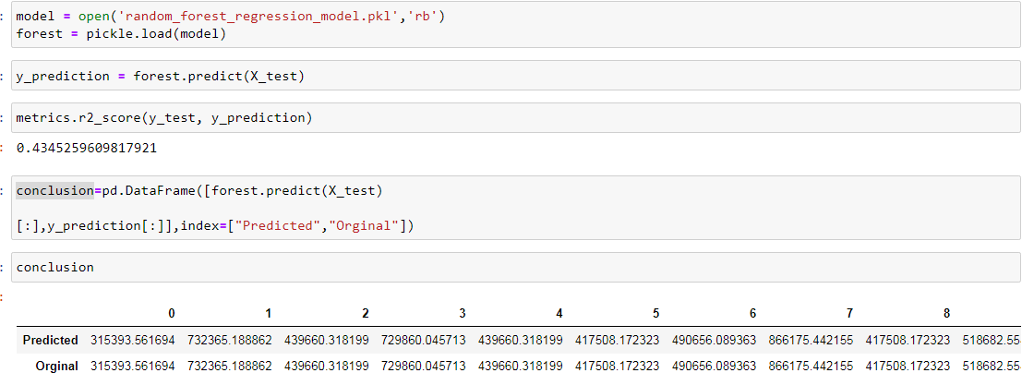
CONCLUSION
· Interpretation of the Results Summary:
First the Car data is read and analyzed reading the features we analyze ,Price is the target column here. All the features are then analyzed, missing data

Slide 28
handling, outlier detection, data cleaning are done. Trend of SalePrice is observed for change in individual features. New features are extracted, redundant features dropped and categorical features are encoded accordingly.
I take a look at the first few rows using the data dictionary provided.I get a sense of what each column represents,I identify the predictors and response variables.I check if there is any unique identifier for each column.
made a note of all the observations as a part of data understanding,in the data there are 5984 variables out of which price is the responsible variable and all the predictors.
Name of the car and model is the unique identifier for each record as a part of data preparation. I start with data cleaning,i start with null values and data types of each column,i bring all the string values together.
Creating dummy variables increases the number of features greatly, highly imbalanced columns are dropped.
created dummy variables to convert categorical variables to numeric variables.

Slide 29
We need this because linear regression can only be done with numeric variables.
Before modelling divided the model into training and testing data.
70% random samples for training data and remaining 30% for testing data.
I began data modelling by creating the first model as Linear regression with all the variables of training data and noted the results of the first model.
Then calculated the Original price and Predicted price from the values observed.
Plotted the graph of feature importances for better visualization and the residual of the final to ensure that normal distribution.
Using the Regressor models calculated the KNeighborsRegressor,SVR,DecisionTreeRegressor, RandomForestRegressor, and observed that the RandomForestRegressor is performing the good precision and calculated the Hyper parameter tuning for RandomizedSearchCV.Finally calculated the rf_random best score.
Plotted the distplot and scatter plot of Y test predictions,and saved the model.

